Slide 1
INTRODUCTION TO ASP.NET CORE
By: Bhawna Gunwani

Slide 2
ASP.NET CORE

Slide 3
ASP.NET MVC Pipeline and Security

Slide 4
AGENDA
Security: Form Authentication
Creating User Login Flow
Accessing Logged In User Details
Creating Base Controller

Slide 5
AUTHENTICATION

Slide 6
AUTHENTICATION
Authentication of user means verifying the identity of the user.
You might need to present your application only to the authenticated users for obvious reasons.
In other words, we can say that it is a process to validate someone against some data source.
IT Company
IT Company
Reception
HR Room
Accounts Section
Authentication
User
Biometrics
Cafeteria
Server Room
Admin Room

Slide 7
AUTHENTICATION
The above image shows the different sections of an IT Company like Reception, HR Section, Accounts Section, Server Room, etc.
At the gate, we have biometrics to verify the employee.
Suppose one user or one employee comes.
This biometrics checks the employee credentials against some data source
and if it is found the employee is a valid employee,
then it only allows entering into the campus. This is nothing but Authentication.

Slide 8
TYPES OF AUTHENTICATION
There are three different authentication providers:
Authentication
Windows Authentication
Forms Authentication
Passport Authentication

Slide 9
WINDOWS AUTHENTICATION
This authentication provider is the default provider for asp.net.
It authenticates the users based on the user’s windows accounts.
Windows authentication relies on the IIS to do the authentication.
IIS can be configured so that only users on the Windows domain can log in.
If users attempt to access a page and is not authenticated,
then the user will be shown a dialogue box that asks the user to enter their username and password.
Then this information is passed to webserver and checked against the list of users in domain.
Based on the result the access is granted to the user.

Slide 10
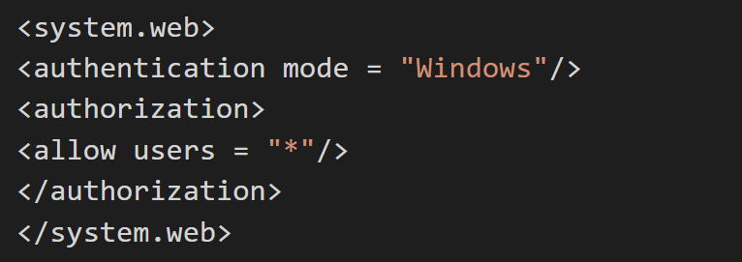
WINDOWS AUTHENTICATION
To use windows authentication, the code is as follows

Slide 11
FORMS AUTHENTICATION
It provides a way to handle the authentication using your own custom logic within the application.
When the user requests a page for the application, asp.net checks for the presence of a special session cookie.
If the cookie is present, asp.net assumes that the user is authenticated and processes the request.
If the cookie is not present, asp.net redirects the user to a web form you provide.
When user is authenticated process the request and indicates this to asp.net by setting a property,
which creates the special cookie to handle the subsequent requests.

Slide 12
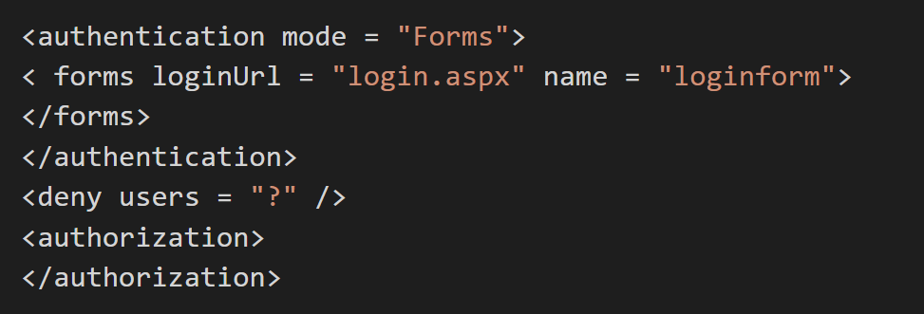
FORMS AUTHENTICATION
To use forms authentication, the code is as follows

Slide 13
PASSPORT AUTHENTICATION
It allows using Microsoft’s passport service to authenticate users of your application.
If your users have signed up with a passport and you are having the authentication mode of the application as passport authentication,
then all authentication duties are offloaded to the passport servers.
It uses an encrypted cookie mechanism to indicate the authenticated users.
If users have already signed into passports when they visit the site,
then they will be considered as authenticated by asp.net.
Otherwise, they will be redirected to the passport servers to log in.
when they are successfully logged in them only they will be redirected back to your website.

Slide 14
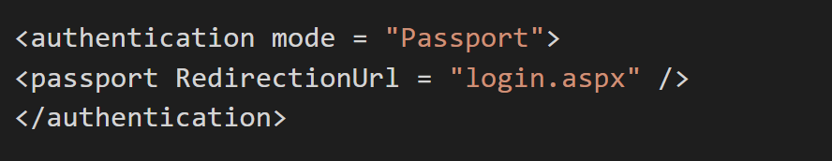
PASSPORT AUTHENTICATION
To use passport authentication, the code is as follows

Slide 15
AUTHORIZATION

Slide 16
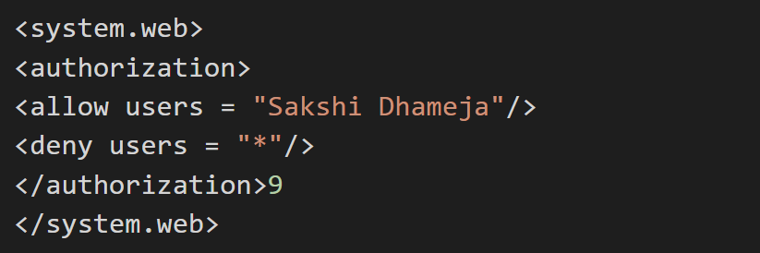
AUTHORIZATION
Authorization is the process of checking whether user has access to resources they requested.
In asp.net, there is two forms of authorization available,
one is file authorization and another is URL authorization.
Syntax:

Slide 17
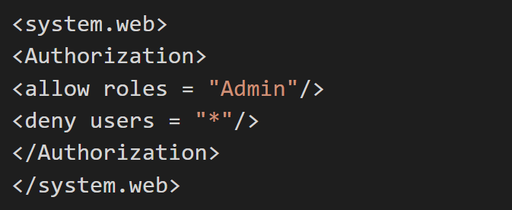
AUTHORIZATION
This code will allow user SakshiDhameja and deny all other users to access that application.
If you want to give permission for more users then just add usernames separated with a comma like SakshiDhameja, coursera, edu, etc.
and if you want to allow only admin roles to access the application
and deny permission for all the roles, then write the following code in web.config.

Slide 18
AUTHORIZATION
File authorization:
- File authorization is performed by the FileAuthorizationModule.
- Uses Control List of web page to resolve whether a user should have access or not.
- ACL permissions are confirmed of the user’s windows identity.
URL authorization:
- In configuration file you can specify the authorization rules for various directories or files using <authorization> element.

Slide 19
DEMO
Identity Core Security in ASP.NET CORE Application

Slide 20

Thank You

Slide 21
Controller

Slide 22
CONTROLLER
A Controller is a special class in ASP.NET Core Application with .cs (for C# language) extension.
By default, when you create a new application using MVC template,
then you can see the Controllers are residing in the Controllers folder.
The Controllers logically group similar types of actions together.
This grouping similar types of action together allows us to define sets of rules such as caching, routing, and authorization which is going to be applied collectively.
The controller class should and must be inherited from the Controller base class.

Slide 23
CONTROLLER
When the client (browser) sends a request to the server,
then that request first goes through the request processing pipeline.
Once the request passes the request processing pipeline, it will hit the controller.
Inside the controller, there are lots of methods (called action methods) actually handle that incoming HTTP Request.
The action method inside the controller executes the business logic and prepared the response which is sent back to the client who initially made the request.

Slide 24
CONTROLLER
Request
Client
Controller
Response
View
Model

Slide 25
ROLE OF CONTROLLER
A Controller is used to group actions i.e. Action Methods.
The Controller is responsible to handle the incoming HTTP Request.
The Mapping of the HTTP Request is done using Routing.
That is for a given HTTP Request, which action method of which controller is going to invoke is handled by the Routing Engine.’
Many important features such as Caching, Security, etc. can be applied to the controller.

Slide 26
DEMO
Creating Base Controller

